Slide 1

Video Game Sales in Tableau
Suzy Jones

Slide 2
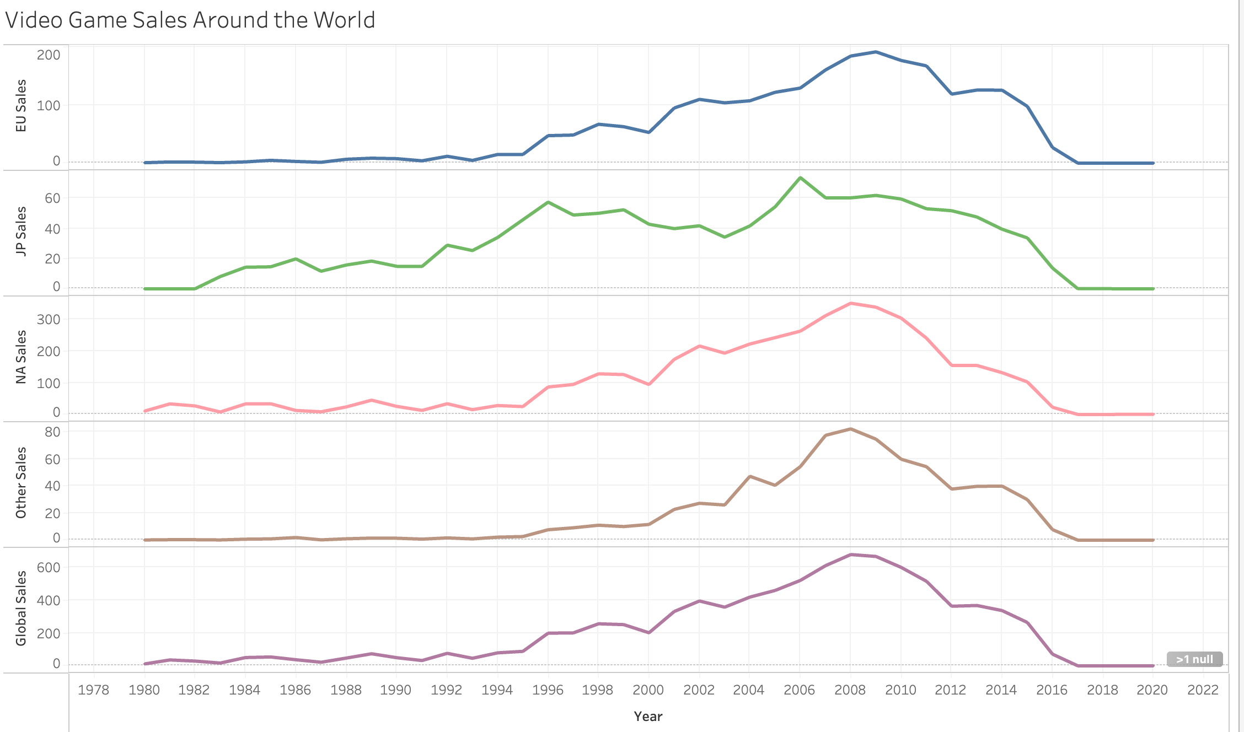
Video Games Sales from 1980 to 2020 ***Video game sales were booming between the years 2006 and 2018

Slide 3
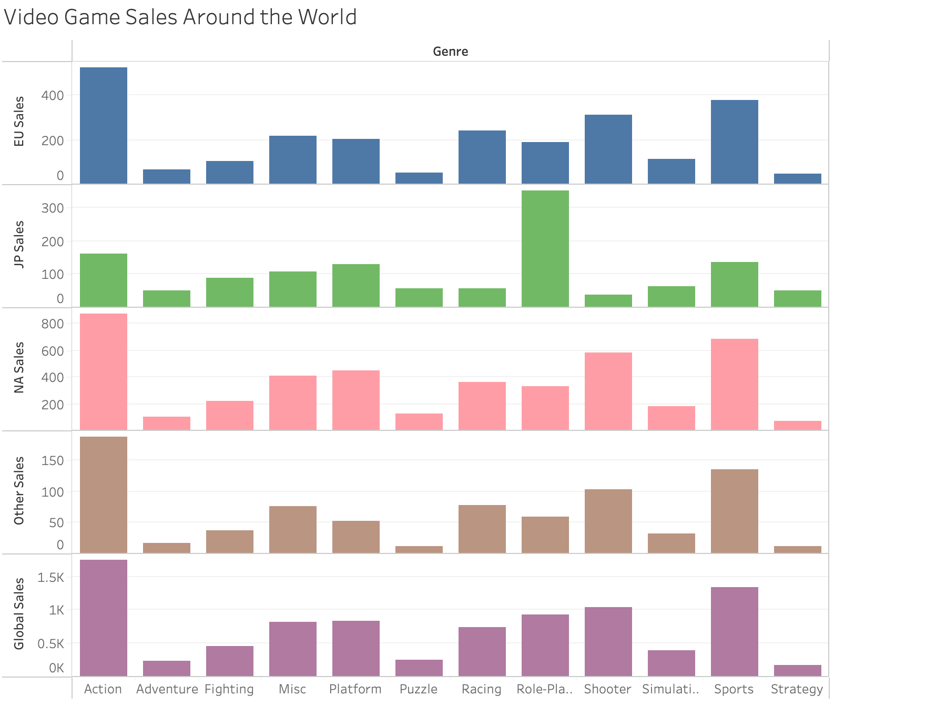
Looking at the connections between the genres of video games and sales around the world, most people buy ”Action” and “Sports” games. Interestingly, ”Role-Playing” games were most popular in Japan, while “Strategy” and “Adventure” games were less popular globally.

Slide 4
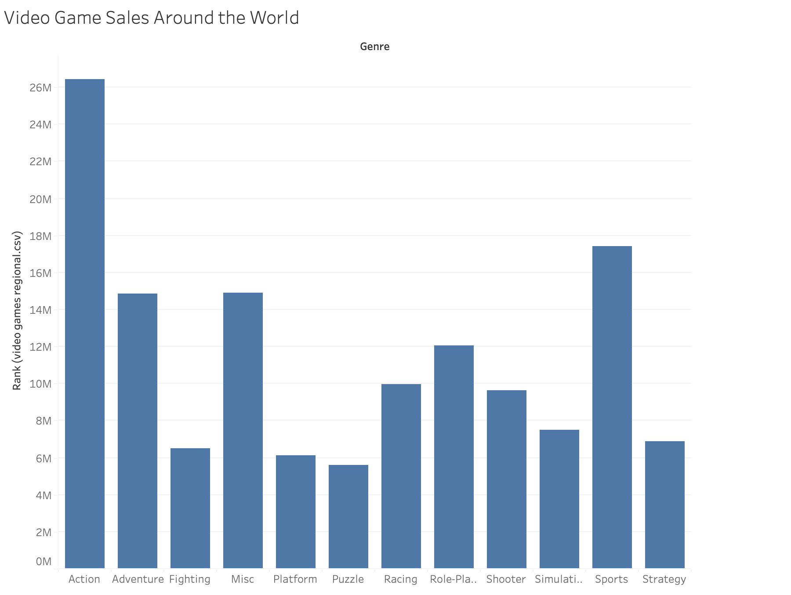
The ranking of video game genres confirms “Action” and “Sports” as the most popular genres of video games.

Slide 5
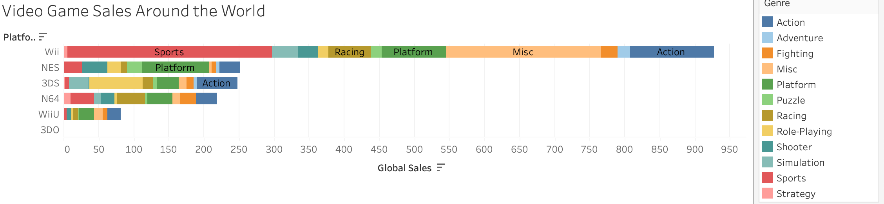
It can also be concluded, the more genres produced, the more successful platform.

Slide 6
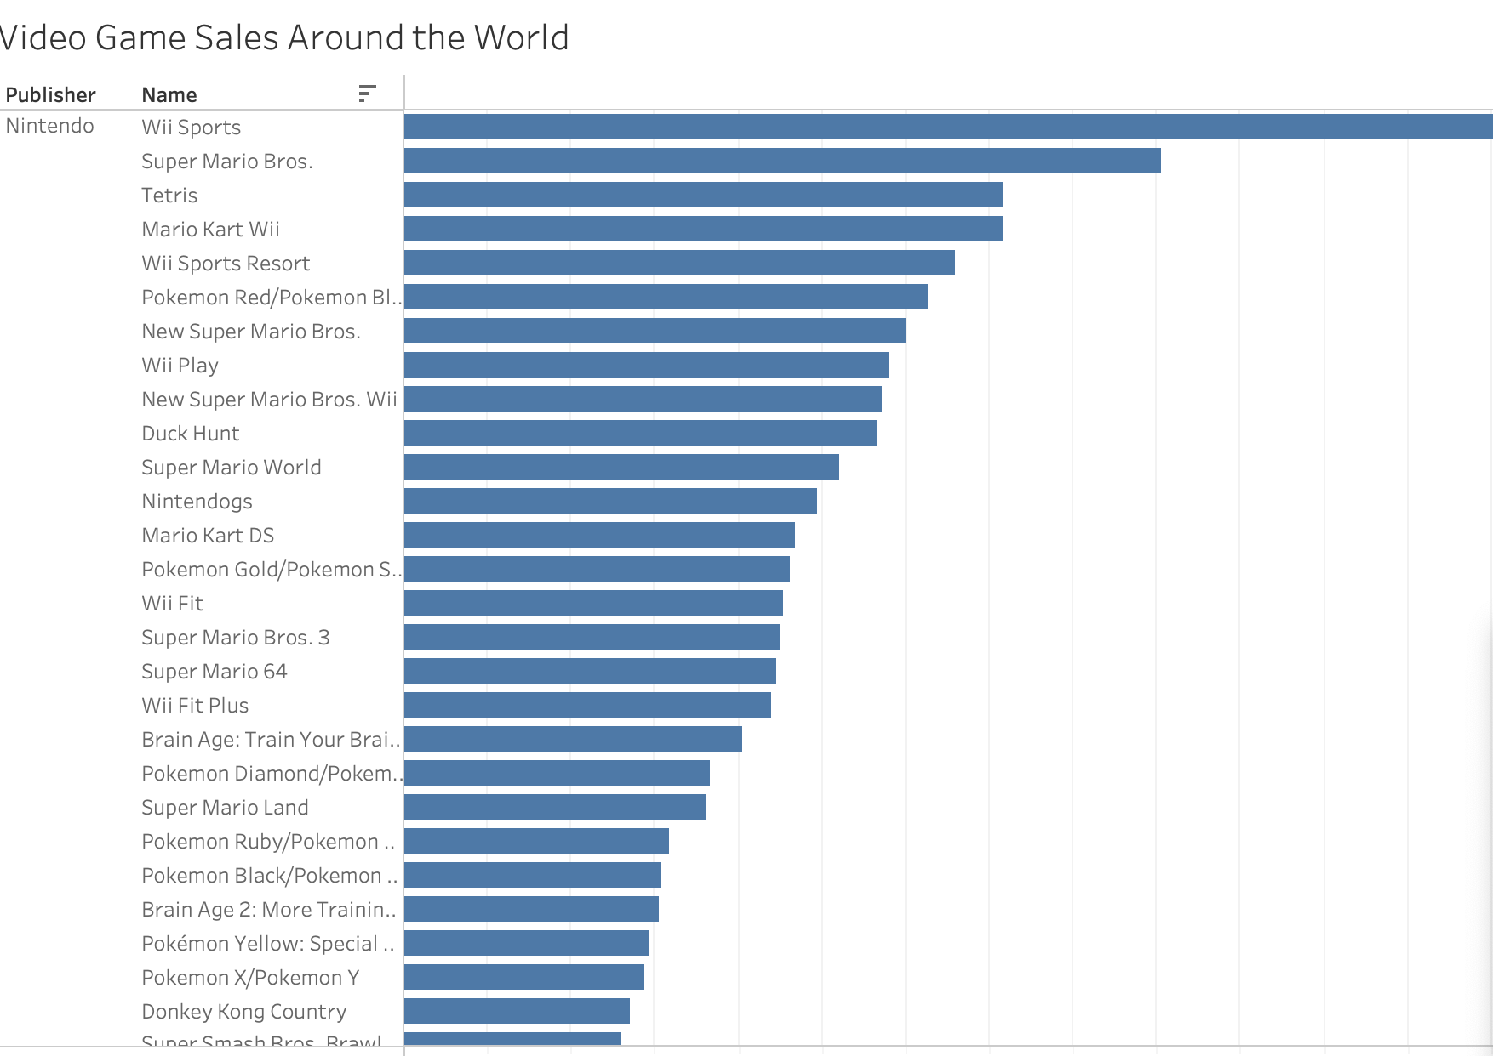
When looking at videos games produced by Nitendo platforms, their success is based on the variety of genres they produce.

Slide 7
Conclusion: If we want to produce a new video game that will be popular throughout the world, it would be best to look into a new sports or action game. It would also be wise for it to be Nintendo completable.

